Slide 1











CRIMES IN INDIA
Analysis of Crime Data by State/UT from 2001-2013
An analytical Aproach By Ankit Shrivas
Project file link : https://colab.research.google.com/drive/1c9qnGLJeFG3h8pXukECLB0P-0fkIvBfr?usp=sharing
Dataset link : https://www.kaggle.com/datasets/meruvulikith/crimes-in-india-dataset-2001-2013

Slide 2



Steps Teken In The Project
1. Imported required libraries: pandas, numpy, matplotlib, seaborn.
2. Loaded the dataset and performed data cleaning (checked duplicates and missing values).
3. Conducted exploratory data analysis (EDA) with summary statistics and visualizations.
4. Investigated trends, correlations, and distributions for key crime categories.
5. Highlighted top states with high crime counts and year-wise trends.

Slide 3
Dataset Overview
Dataset Source: Kaggle (Crimes in India Dataset 2001-2013)
Rows: 9840, Columns: 33
Key Attributes:
Crime types: Murder, Rape, Robbery, Dowry Deaths, etc.
Geographical details: States/UTs and Districts
Temporal data: Year-wise statistics

Slide 4


Intoduction
This project analyzes crime data across Indian states and districts from 2001 to 2013. The aim is to uncover patterns in various crime categories and understand regional disparities to support effective policymaking.

Slide 5

PROJECTS OBJECTIVE
HOME
1. Identify total counts and trends of major crimes (e.g., Murder, Rape, Theft).
2. Determine states with the highest crime rates and their variations.
3. Analyze correlations between crimes like dowry deaths and cruelty by relatives.
4. Provide insights for law enforcement and policymaking.

Slide 6
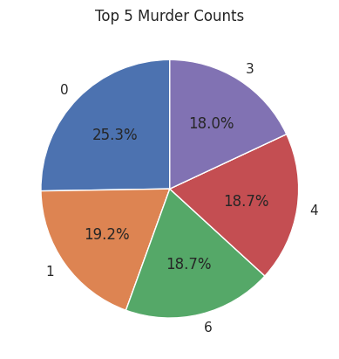
TOP 5 MURDER COUNTS
The pie chart illustrates the distribution of murder counts in a particular dataset. The largest category, represented by the blue slice, accounts for 25.3% of the total murders. The remaining categories, labeled 1, 3, 4, and 6, each represent roughly 18-19% of the total.

Slide 7
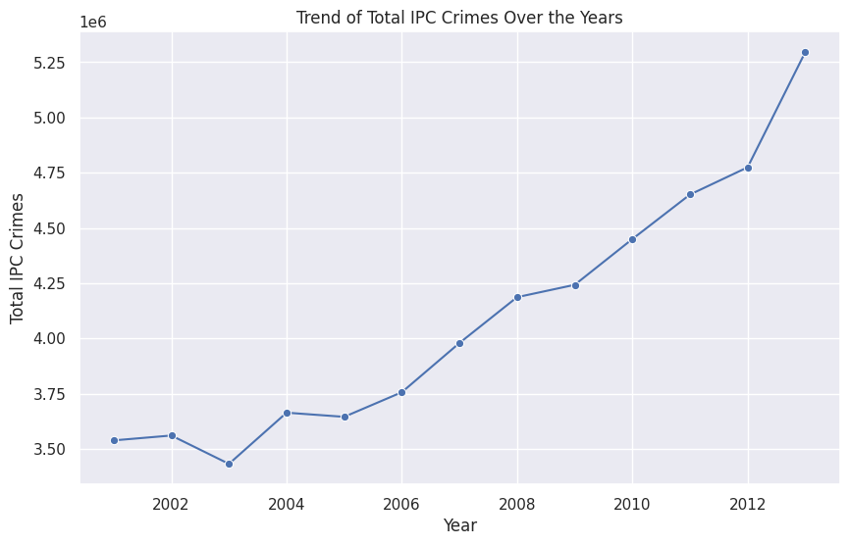
Trend of IPC Crimes Over the Years
The line graph depicts the trend of total IPC (Indian Penal Code) crimes from 2002 to 2012. It reveals an overall upward trajectory, with notable dips in 2003 and 2005. The most significant increase occurs between 2010 and 2012.

Slide 8
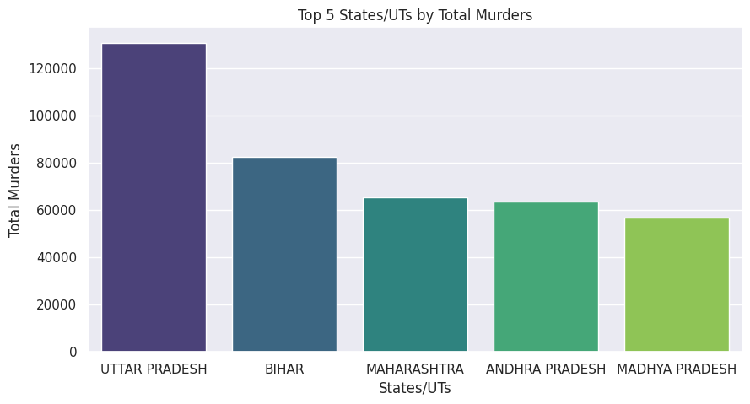
Top 5 States/Uts by Total Murders
The bar chart shows the top 5 states/UTs by total murders. Uttar Pradesh has the highest number of murders, followed by Bihar, Maharashtra, Andhra Pradesh, and Madhya Pradesh.

Slide 9
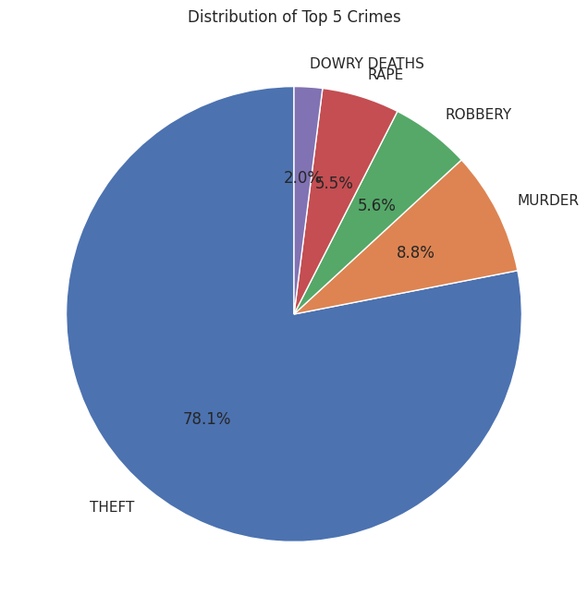
Distribution of Top 5 Crimes
The pie chart illustrates the distribution of the top 5 crimes. Theft is the most prevalent, constituting a significant 78.1% of the total. Following theft, murder accounts for 8.8%, robbery 5.6%, rape 5.5%, and dowry deaths 2.0%.

Slide 10

Findings and Insights
Top crimes: Murder, Rape, and Theft dominate the dataset.
Yearly trends show a consistent increase in IPC crimes over time.
States with highest murder and robbery cases: [List key states from analysis].
Strong correlations observed between dowry deaths and cruelty by relatives.
Crime distribution highlights regional disparities in major offenses.

Slide 11
Conclusion
Data analysis reveals significant crime trends and regional patterns.
High-crime states need focused interventions and improved law enforcement.
Social issues like dowry deaths require stricter laws and awareness programs.
Yearly trends reflect the need for continuous monitoring and adaptive policies.
Insights are valuable for targeted crime prevention strategies.

Slide 12
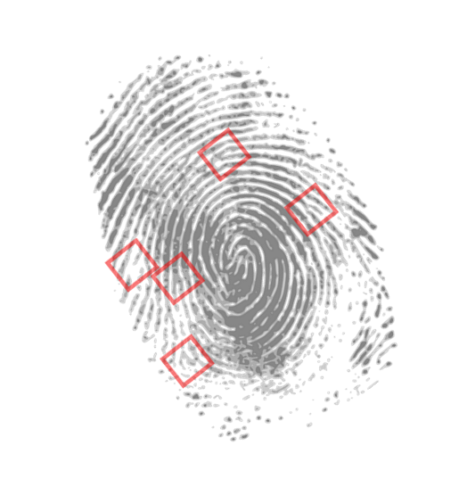
THANK YOU

